Slide 1
Topic Modelling
Sentiment Analysis
with
Machine Learning and NLP
Yeo Siew Ping・Darren Hum・Edwin Wan
IBIS BUDGET REVIEWS

Slide 2
Content
Business Context //3-9 Edwin
Workflow // 11-22 Siew Ping
Recommendations and Challenges // 23-27 Darren

Slide 3
Post-covid phase uncertainty can be mitigated by utilizing data to guide decisions
VUCA world post-covid for hospitality industry, what could happen next?
Passing storm with rebound to pre-covid levels?
Company partnerships and acquisitions?
Steep decline across the board?
Focus on travel and trade within Asia?
Using data to guide decisions can resolve some uncertainty.
https://www2.deloitte.com/nl/nl/pages/consumer/articles/four-scenarios-for-travel-and-hospitality-leaders-after-covid-19.html

Slide 4
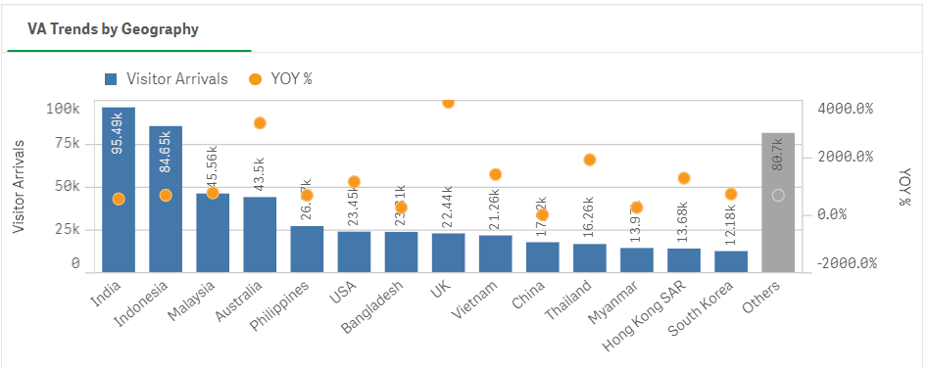
Arrivals to Singapore experiencing some growth, especially from UK and AUST
Credits to Singapore Tourism Board

Slide 5
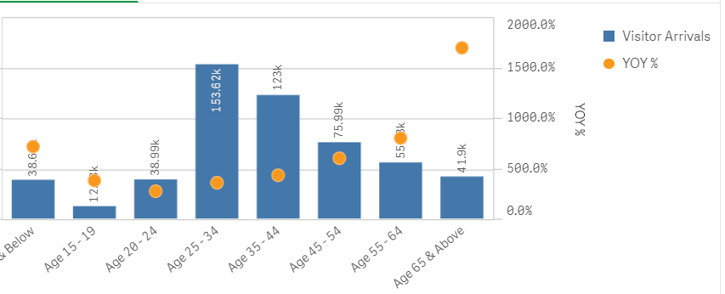
Arrivals to Singapore growing across the board
Credits to Singapore Tourism Board

Slide 6

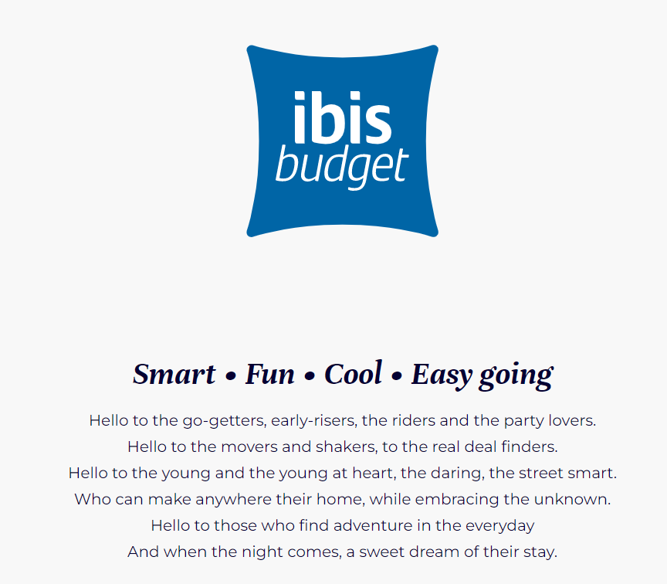
Ibis acquired Fragrance Hotel right before Covid
Previously known as Fragrance hotel
Bought over by Accor Group, one of the biggest hotelier globally, in 2019
Rebranded to Ibis Budget
Refurbishment done to keep in line with branding and image

Slide 7
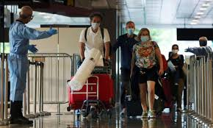


Key Summary 1:
Critical period for Ibis Hotel to understand customers
End of 2019
2020 - 2021
Current
Accor Acquisition and Rebranding
COVID
Uncertainty
Post-Covid Increase in inbound travellers and potential customers
Notes:
Improving revenue would impact the business greatly as based on Accor Financial report, the hotels in the economy arm of Accor hotels which includes IBIS budget is seeing a fall in revenue LOL with the worst performance taking place in Asia Pacific where Singapore hotels is house under

Slide 8
NLP and machine learning allows us to condense reviews into actionable insights
Reviews are an important touchpoint for customers to provide valuable feedback
Usually require large number of man-hours to read and understand reviews
Often difficult to condense into clear insights
Topic modelling is an NLP technique to identify topics across a set of documents
Sentiment analysis allows us to classify reviews into positive and negative sentiments

Slide 9
Key Business Questions
Business Questions | Proposed Solution
What areas can we allocate resources to improve customer experience? | Topic modelling to assess which topics customers are giving positive/negative feedback about.
How can we respond promptly to negative reviews for service recovery? | Sentiment analysis to indicate worst reviews by sentiment polarity score Dashboard to highlight worst reviews so business can easily identify

Slide 10
Process

Slide 11








Workflow
Web-scraping to obtain reviews from TripAdvisor
Text Pre-Processing
Topic Modelling: Latent Dirichlet Allocation (LDA)
Sentiment Analysis using TextBlob
Delivery:
Tableau Dashboard + Streamlit Deployment
Topic Classification:
Linear SVC
EDA

Slide 12
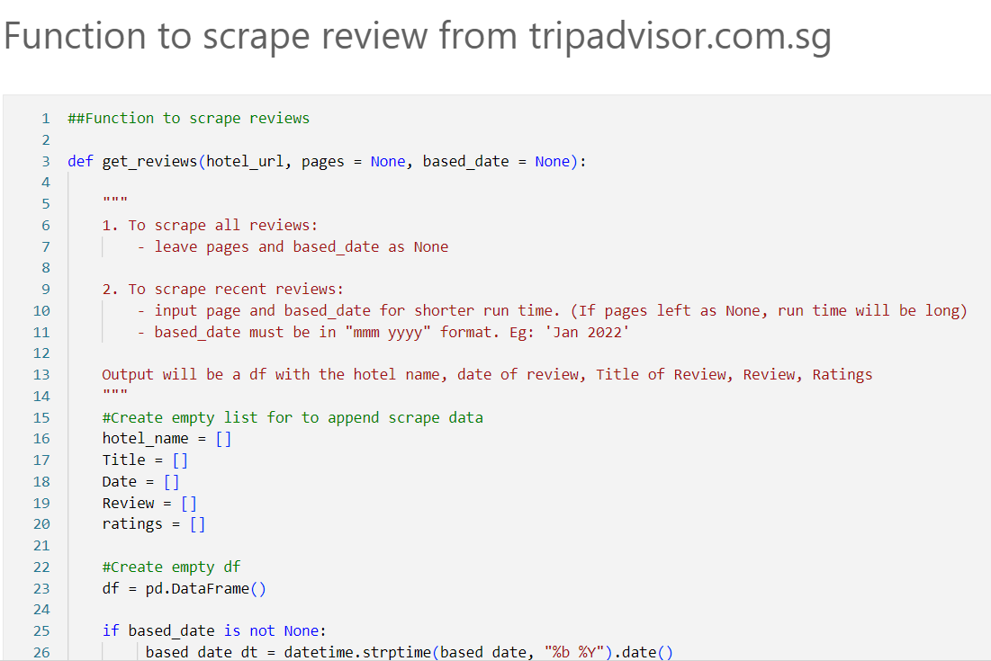
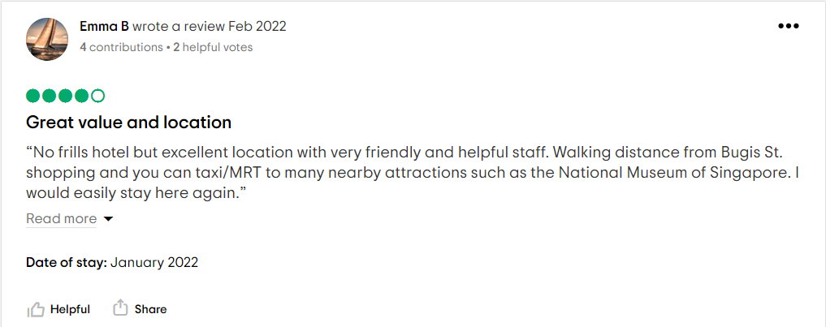
1. Web - Scraping
TripAdvisor reviews are scraped using Selenium
Versatile function to either scrape all reviews, first few pages or new reviews based on date input
Include hotel name, date of review, title, review, star ratings
Saved as csv file to cater for different use

Slide 13
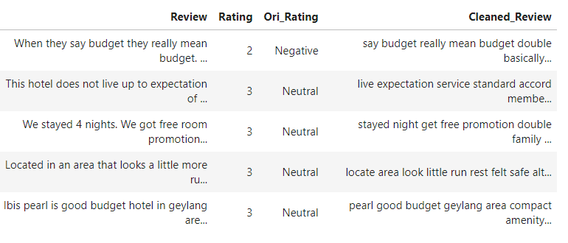
2. Text Processing
Change text to lowercase
Remove noise - Punctuations, Emoticons, Symbols
Tokenisation
Remove Stop Words
Lemmatization

Slide 14
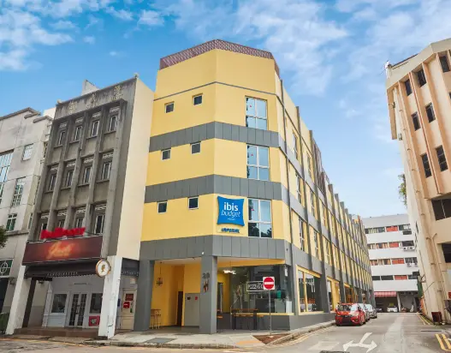
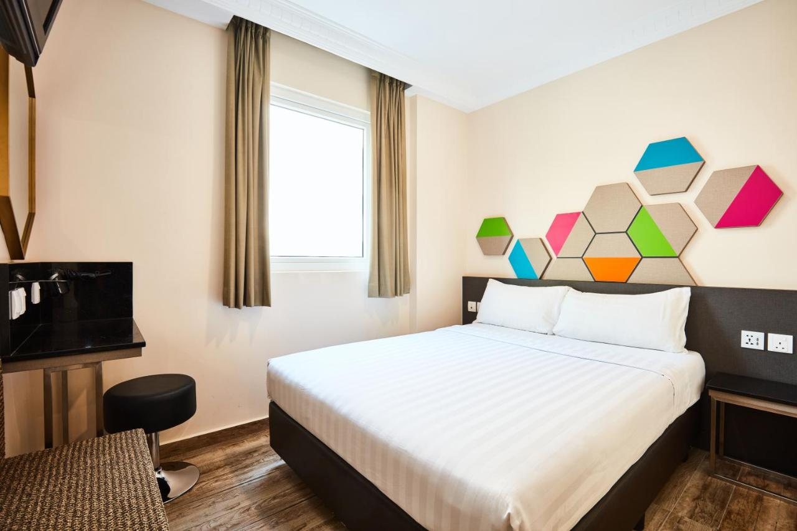
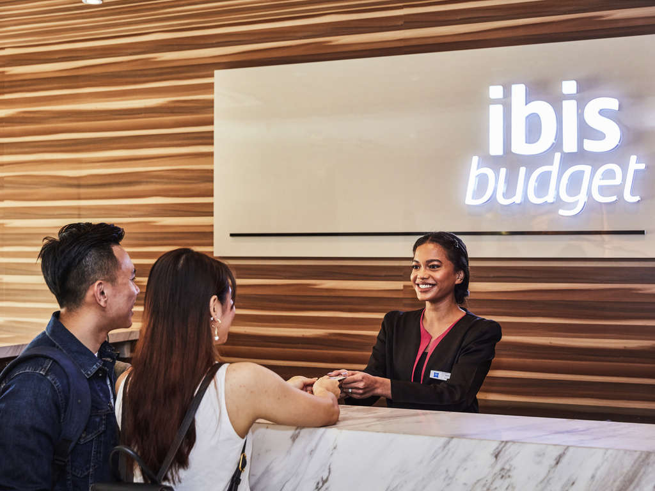
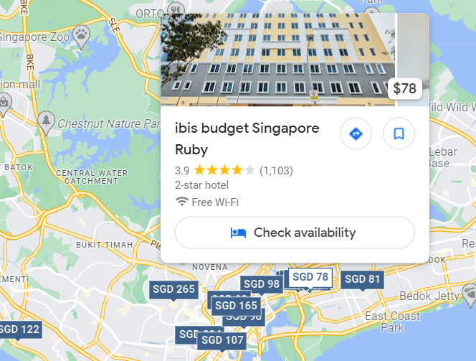
Topic Modelling: LDA
Input processed text into Latent Dirichlet Allocation (LDA) model
Best Model identifies 4 distinct clusters
4 underlying topics were identified and used to label each review
Environment
Room Amenities
Service
Location
Notes:
Show pyLDAvis plot

Slide 15
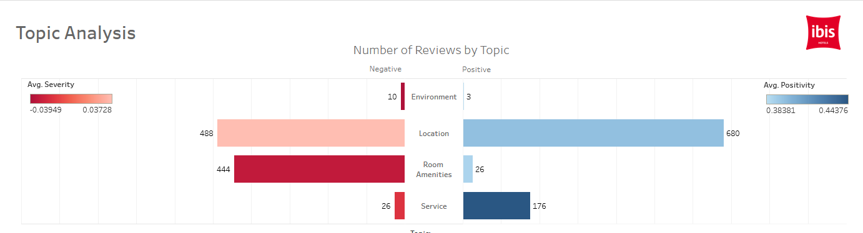
Sentiment Analysis: Textblob
Use TextBlob to obtain sentiment scores of each review (-1 to 1)
Allocate positive, negative, neutral based on threshold of sentiment score

Slide 16
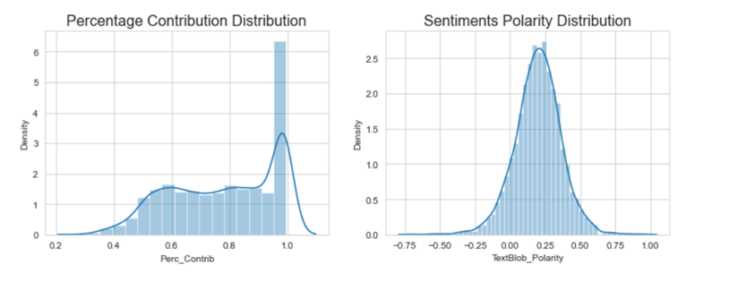
EDA
Most of the reviews have substantial contribution (>50%) towards the topics
Reviews are also mostly on the slightly positive side

Slide 17
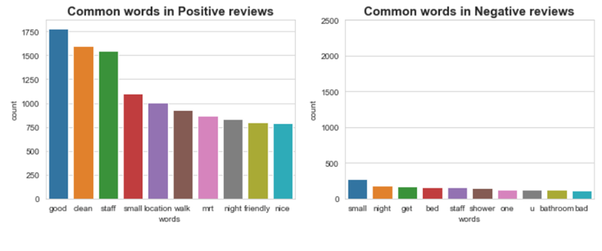
EDA
Positive reviews - Location, Service
Negative reviews - Room Amenities

Slide 18
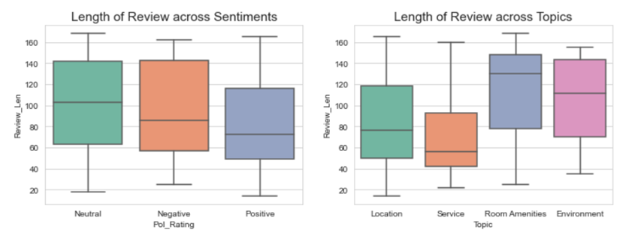
EDA
Neutral reviews and reviews on Room Amenities are the longest

Slide 19
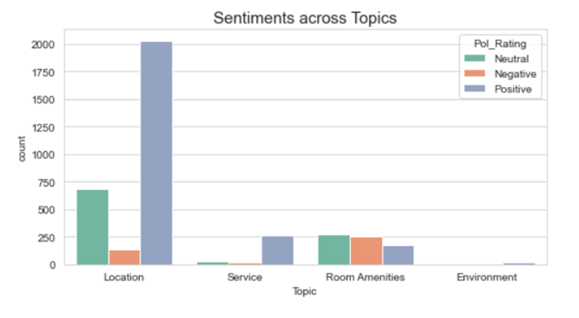
EDA

Slide 20
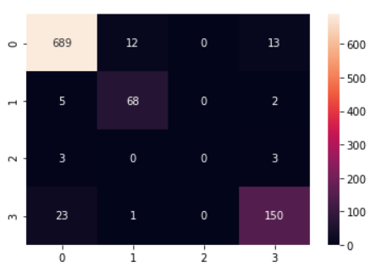
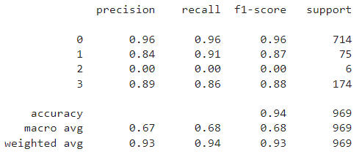
Topic Classification: Linear SVC
Train model to classify new reviews to one of the 4 topics
Random Forest, Support Vector Machine, AdaBoost, Linear SVM
Class weights adjusted to address data imbalance issue
TF-IDF Vectorizer
Linear SVC model best performance at 0.94 accuracy after hyper-parameter tuning with no model overfitting

Slide 21
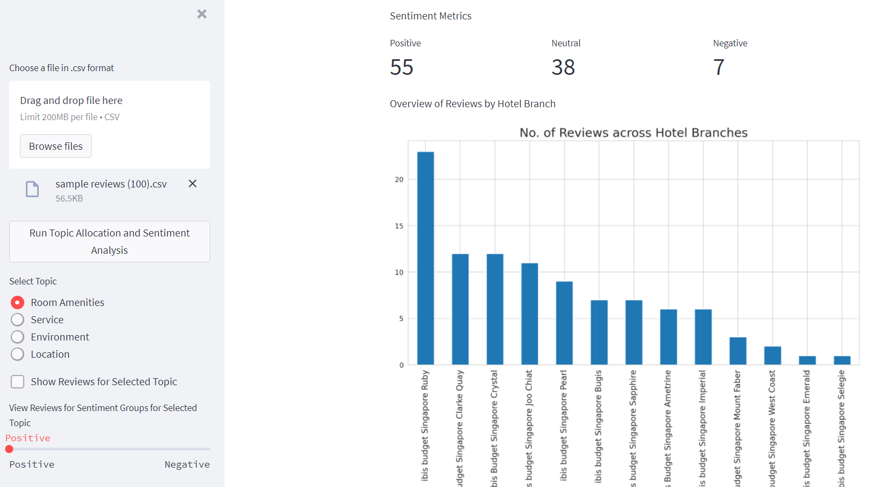
7. Streamlit Deployment
Deployed text processing, sentimental analysis and topic classification on streamlit
Easy access for user including those with little programming knowledge
Value-add to the process for Quality and Service Assurance of the property
Click here!!!

Slide 22
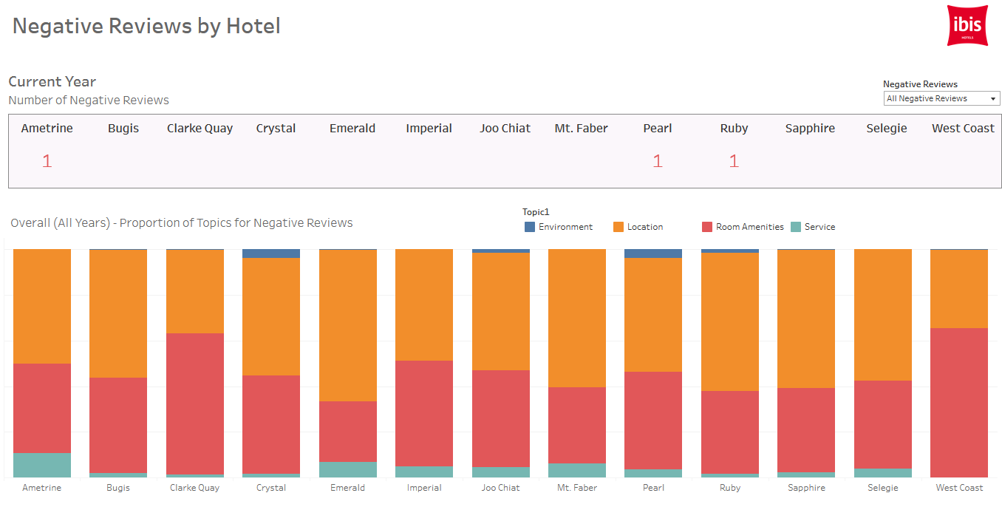
7. Dashboard
Topic Analysis to dive into areas of improvement
For business to identify current year performance
Click on image to go to Tableau Dashboard

Slide 23
Room amenities is a topic that most affects customers sentiment negatively
Based on the difference in the number of positive and negative reviews, as well as the polarity score (color):
Ibis has been doing well in Service
The worst reviews are related to room amenities
Location is talked about often, but does not impact polarity as much, with similar number of negative and positive reviews

Slide 24
Ibis hotel can work on cleanliness and comfort
Mere words cannot express my disgust at what I found in this hotel. Dirty, disgusting blood soiled pillow case and sheets and a smell that the fragrance pumped into the rooms could not hide. What did I expect for the price? Nothing like what I got!
I'm very disappointed when I stayed in this hotel. Room are too small and windowless. Service are poor. Staff don't have initiative to provide help for their guest. I will not book again to this hotel because I don't get what I pay for.
One of a terrible stay in SG, the bathroom wasn't cleaned by the time that we moved in, towels weren't changed, so that we had to ask for room changing, which, end up with getting a smaller room. The 2 compliment wi-fi accounts didn't work with my macbook air but didn't want to bother with the hotel staff anymore, so just use my cellular at the time.
Worst hotel ever stayed in room to small for 2 people bed uncomfortable it was like sleeping on wood had to pay $10 for wifi. Breakfast at cafe next door was so terrible could not eat it. Would not recommend to stay there
From samples of the worst reviews on room amenities, customers complained about:
Hygiene and cleanliness
Size of room
Comfort
Basic expectation of all guests!

Slide 25
Ibis hotel can create a unique service culture
From samples of reviews on service, customers have good feedback
helpful
friendly
polite
However…
The words used to describe service is very generic to good service in hotels.
Ibis can consider building a unique culture where guests will use words that are more reflective of
“SMART, FUN, COOL, EASY-GOING”
Staff are accommodating. Always assured us if we are need assistant. Even our tour in Universal Studio was purchased to them and slight lower than regular rate when purchased at Universal Studio. Although the place is far in mrt.
The hotel is located quite conveniently. Easily to get cabs. Room wise is as good as the price. Affordable and above my expectation. I really like the cleanliness of the room. Staff was very helpful and I did get their names; Seri and Kim. They helped me politely and with patience with directions as I asked too much. Thank you and I'll be sure to come here again and recommend to my friends.
This was my second 14 day stay at The Fragrance Hotel-Royal. I highly recommend this hotel!!! The rooms are super clean. The staff is extra friendly and helpful. The hotel is located walking distance to Vivo City!!! 3rd floor housekeeping manager, Richard, goes out of his way to make sure I always have a comfortable and pleasant experience. I will MOST DEFINITELY continue to stay at this hotel when I visit Singapore mainly because of the great service and friendly hotel staff.

Slide 26
Challenges
Issues faced when scraping data from TripAdvisor due to changing elements and pop up layers
Unsupervised learning can be difficult to tune to get the best results that are interpretable
Deployment on AWS and to Streamlit
Money No Enough

Slide 27
Links to Other Products
Tableau Dashboard: https://public.tableau.com/views/ML-hotel-reviews-sentiment-and-topic-1_0/1_Introduction?:language=en-US&:display_count=n&:origin=viz_share_link
Deployed Streamlit app: https://share.streamlit.io/siewpingyeo/capstone-project--end-to-end-ml-on-topic-classification-and-sentiment-analysis/main/Streamlit/streamlit_app_capstone.py
GitHub Repo (Main): https://github.com/SiewPingYeo/Capstone-Project--End-to-End-ML-on-Topic-Classification-and-Sentiment-Analysis

